Slide 2
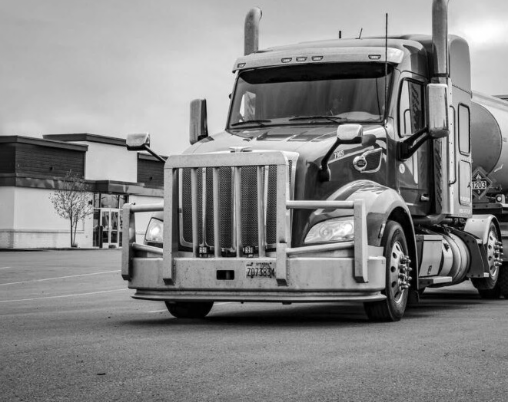

BRAD HALL FUEL ANALYSIS
By the 2026 Econ Games Team

Slide 3
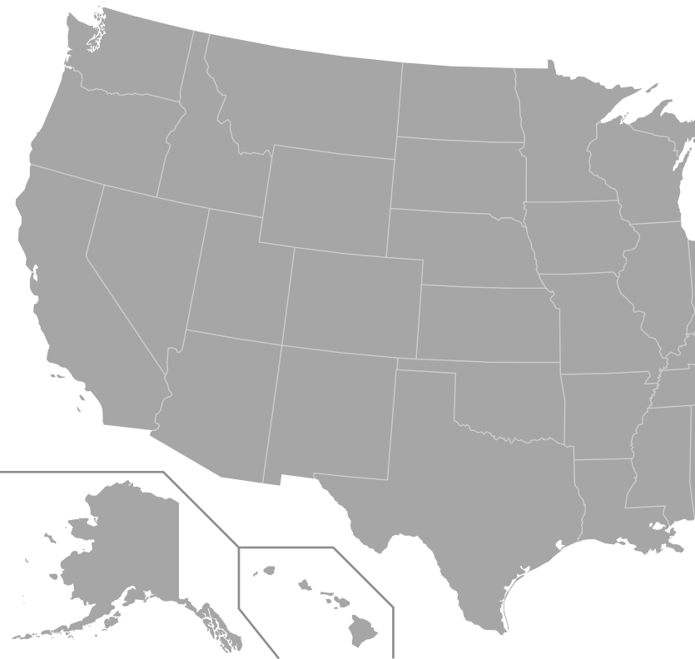




















Is it feasible
to transport
fuel cross-regionally?
Fuel Pipelines
Notes:
Many clients, but within-region delivery costs are fixed (we only model inter-region transport).
Our focus: can we make money transporting fuel between regions?
Note constraints: only trucking considered; costs are approximate.

Slide 4
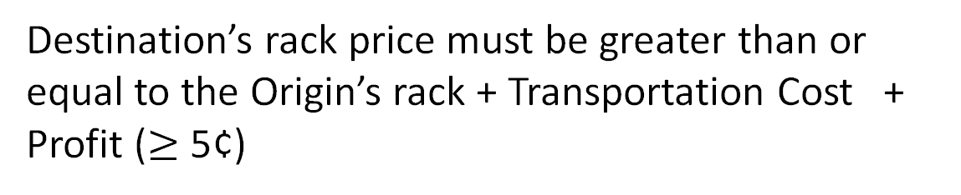
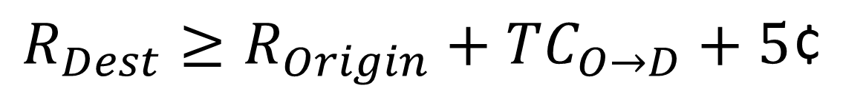
Opportunity Model
Profit
$$R_{Dest}≥R_{Origin}+TC_{O→D}+5\text{¢}$$
TC
Rack
Destination’s rack price must be greater than or equal to the Origin’s rack + Transportation Cost + Profit ($≥$5¢)
Rack
Without
Arbitrage
With
Arbitrage
Notes:
Explain why 5¢ is the threshold (safety margin, covers minor errors).
Maybe switch visual to line graph??
Mention: model scalable, can incorporate new regions, lanes, or clients.

Slide 5

Transportation Cost Calculations
Origin | Destination | Distance (mi) | Cost per Mile | Tanker Size (gal) | Total Cost per Gal
Argus Gulf | Salt Lake | 1500 | $2.50 | 8500 | $0.44
Las Vegas | Pheonix | 290 | $2.50 | 8500 | $0.09
LA | Alba | 787 | $2.50 | 8500 | $0.17
Notes:
Moderate-high assumptions to be conservative.
Taxes apply to fuel used in transport, not cargo.
Fees assumed covered in our estimates.
Emphasize: assumptions are conservative, so actual profits could be higher.

Slide 6
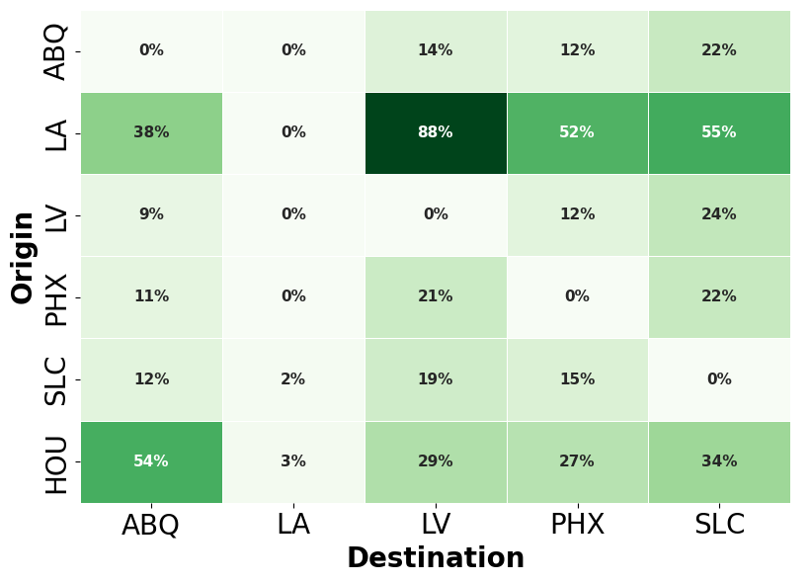

Frequency of Days with $≥$ 5¢ profit
Notes:
Show where arbitrage happens most often.

Slide 7
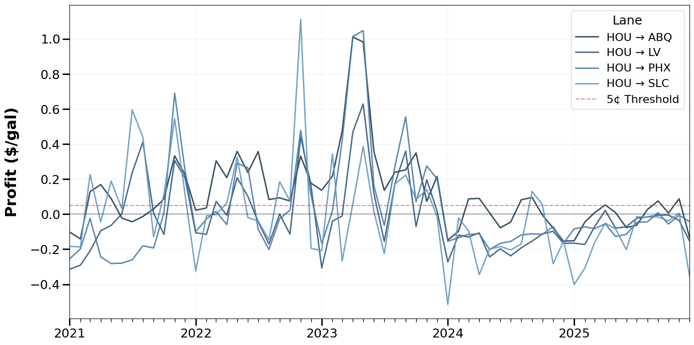
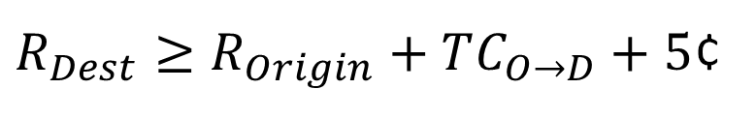
Profit Opportunities in HOU Lanes
$R_{Dest}≥R_{Origin}+TC_{O→D}+5$¢

Slide 8
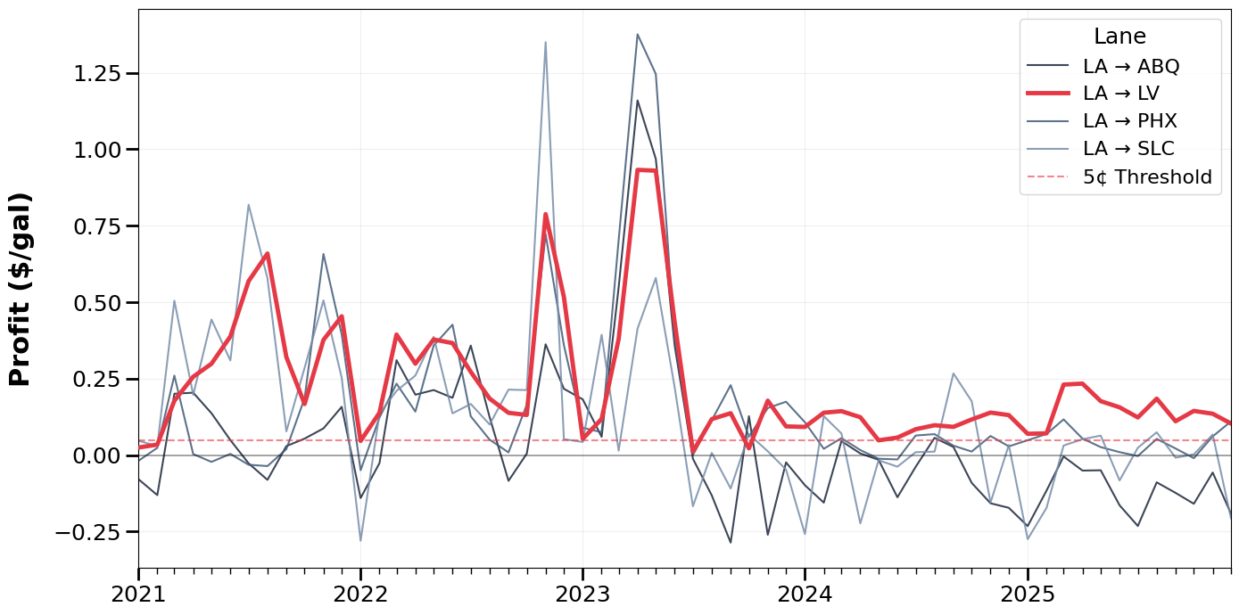
Profit Opportunities in LA Lanes
$R_{Dest}≥R_{Origin}+TC_{O→D}+5$¢
Notes:
Take a second to go over all of these
Weekly avg lines (2021–2023).
Grayed out lanes except LA → LV in red.
BC costs were so much higher, LA → SLC
Dashed 5¢ line as threshold.
Observations to call out:
2021–2022: high volatility → many arbitrage opportunities.
2023: prices converge, opportunities decrease.
LV still has strong, consistent profit.
Even in transportation costs increased quite a bit, there’s room for profit LA-LV
Optional context:
Briefly mention global events (COVID, supply chain, geopolitical shocks) — just 1–2 sentences max. Avoid deep dive; focus on how it affects arbitrage volatility.
TRANSITION LINE: Is that enough to be worth it? Let’s look at 2025.

Slide 9
Profit Opportunities in LA Lanes
292
Profitable
days

Slide 10
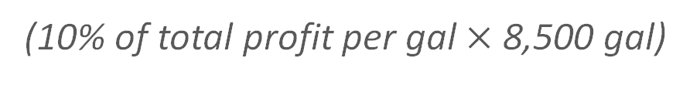
Profit Opportunities in LA Lanes
10% Captured Opportunities:
$37K ​
annual added profits per truck
292
Profitable
days
$1,282​
annual added profits per truck per trip
(10% of total profit per gal $×$ 8,500 gal)

Slide 11
Conclusion
There are millions of potential profits in cross-regional fuel transport.
Apply our model to monitor real-time rack prices.
Notes:
BRING RED
Goal: Clear, actionable takeaways.
Content:
LA → LV is consistently profitable; LA → others occasionally.
Arbitrage less profitable now than 2021–2022, but LV lane remains attractive.
Recommend: monitor rack price spreads and volume opportunities, adjust trucking allocations dynamically.
Optional: suggest future improvements:
Incorporate real transport costs (taxes, fees) by lane.
Include client delivery costs.
Look at seasonal or monthly patterns to optimize routing.
Visual: Simple slide with 3–5 bullet points + small graphic of profitable lane.

Slide 12

Appendix
Distance is city center to city center
Trucks are owned
$30/hr Truck Drivers
Avg. Tanker Size is 7500 gallons
Other methods of transportation not considered due to scope
Not Include NYMEX because it is a market index

Slide 13
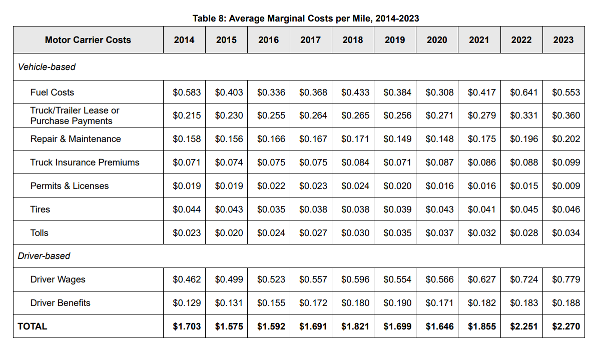
Source: American Transportation Research Institute​
Notes:
Source: American Transportation Research Institute

Slide 14
More sources to look into
Website that gives federal excise taxes on diesel fuel
https://www.fhwa.dot.gov/policyinformation/motorfueldata.cfm?utm_source=chatgpt.com

